Slide 1

GLM
Justin Grosz

Slide 2
Today’s Agenda
Review Last Week’s Homework
GLM (General Linear Model Vs. Generalized Linear Models)
Key Outputs From GLM
In Class Work

Slide 3

Nearest Neighbors HW

Slide 4
Nearest neighbors hw review
The goal of each week isn’t building a model, it is how we can use the model to solve the problem
Finding the optimal model isn’t your end point

Slide 5
GLM

Slide 6
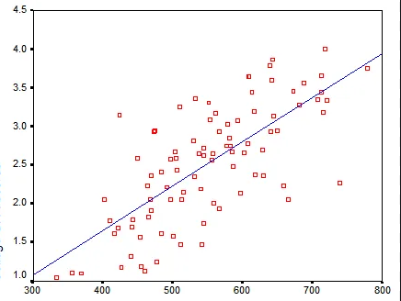
General Linear Model Vs GeneralizED Linear Models
General Linear Model
More Commonly Referred To As Linear Regression
One Independent & One Dependent Variable
Typical Intro To Predictive Analytics ->
Example: Is There A Relationship Between Movies Shown & Seats Sold
Yi=β0+βxi+ϵi

Slide 7
GeneralizED Linear Models
Generalized Linear Models
Based Off Assumptions Of A General Linear Model
Dependent Variable Is Random But Has Normal Distribution
Explanatory Variables
Link Function -> Ties Step 1 & 2 Together
Examples of Generalized Linear Models
Multiple Regression Analysis
Logistic Regression (Cover Next Week)
ANOVA

Slide 8
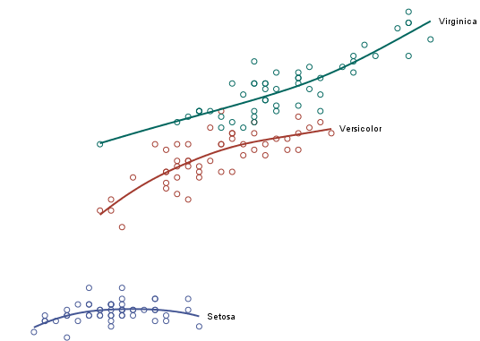
Multiple Regression
Similar To Linear Regression But Dealing W/ 2 or More Independent Variables
Goal is to predict a value
Examples:
Moneyball
Stock Prices
Inventory

Slide 9
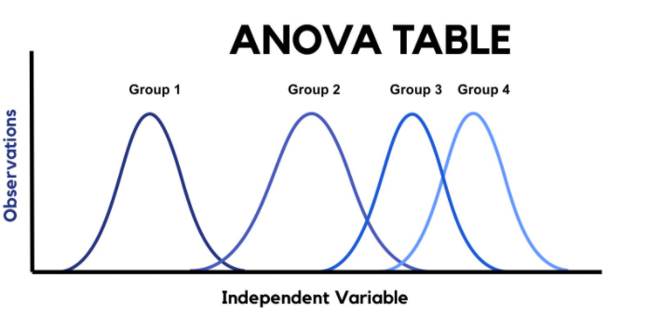
ANOVa
Finding Significant Changes Between Groups
One Way Vs Two Way
How Many Independent Variables Are You Using
1 variable ->One Way
Multi -> Two Way
Example:
Do Any Age Groups Purchase Products Than Others
Do millennials and baby boomers buy toothpaste the same way
Used A Lot In Marketing/Healthcare

Slide 10
Reading GLM Results

Slide 11

Example To Keep In Mind
Predicting Time Watched Per Individual
Genre
Release Year
The time of day you watch
The devices you are watching Netflix on
Completion

Slide 12
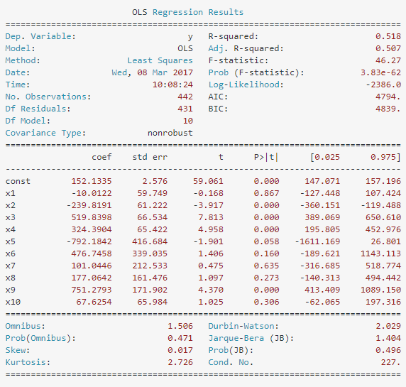
Key Points
In Any Regression Model, The Two Most Important Statistics Are
P Value
Coefficients
This will help us indicate which levers we can use for the business

Slide 13
P Value
Simply Tells Us Which Variables Are Significant & Which Ones Are Not
Starting Point
Helps Us Narrow Down Our Base
How Could Netflix Influence Time Watched If They Knew…
Series # was important and…
Type of device were important

Slide 14
Coefficients
Important For Understanding Variable Impact
Positive/Negative
Which Variables Have More Impact Than Others
If Netflix finds out that Series # and Device Type Mobile has a negative coefficient (in relation to time watched), what could they do

Slide 15
Other Key Points
Regression
R^2
All Models
MSE
AIC

Slide 16
Optimizing

Slide 17
Common mistakes
Selecting Your Own Variables
Not Converting Categorical Variables Ahead Of Time
Focusing On Too Many Variables

Slide 18
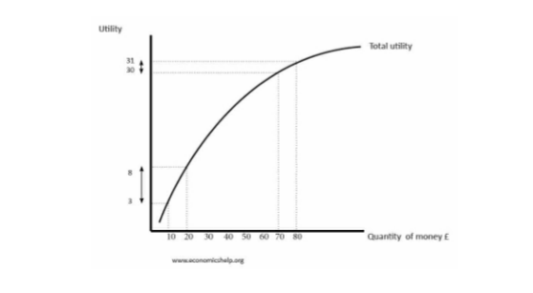
Selection Methods
Forward
Backward

Slide 19
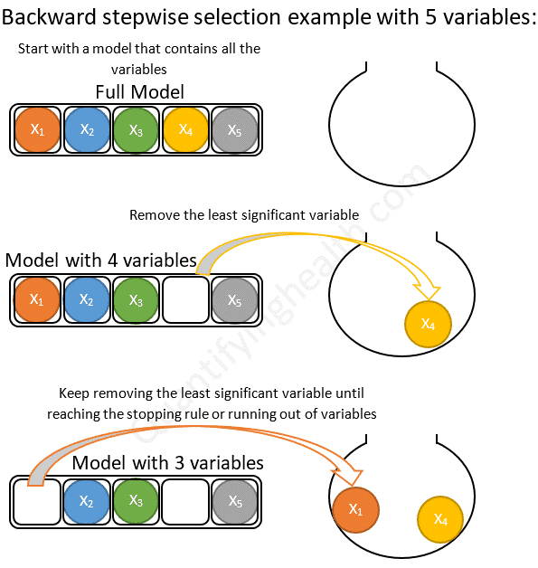
Selection Model Process
Mathematically eliminate unnecessary variables
Using a statistic such as AIC or MSE
Find optimal amount by
Going forward
Going backward

Slide 20
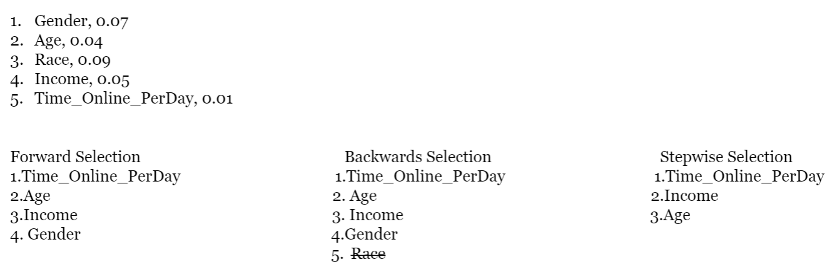
Example
Netflix model had these five variables
Value next to them is p-value
Here is how the model would select

Slide 21
In Class Example: Linear regression

Slide 22
Loading data
import matplotlib.pyplot as plt
import numpy as np
import pandas as pd
from sklearn import datasets, linear_model
from sklearn.metrics import mean_squared_error, r2_score
from sklearn.model_selection import train_test_split
import statsmodels.api as sm
from scipy import stats
bst=datasets.load_boston() #Looking at house prices in Boston

Slide 23
Data dictionary
CRIM per capita crime rate by town
ZN proportion of residential land zoned for lots over 25,000 sq.ft.
INDUS proportion of non-retail business acres per town
CHAS Charles River dummy variable (= 1 if tract bounds river; 0 otherwise)
NOX nitric oxides concentration (parts per 10 million)
RM average number of rooms per dwelling
AGE proportion of owner-occupied units built prior to 1940
DIS weighted distances to five Boston employment centres
RAD index of accessibility to radial highways
TAX full-value property-tax rate per $10,000
PTRATIO pupil-teacher ratio by town
B 1000(Bk - 0.63)^2 where Bk is the proportion of blacks by town
LSTAT % lower status of the population
MEDV Median value of owner-occupied homes in $10000’s

Slide 24
Convert To dataframe & Split Training/Test
df = pd.DataFrame(np.c_[bst['data'], bst['target']],
columns= np.append(bst['feature_names'], ['target’])
df.head()
#Split independent from dependent variables (x,y)
y=df[['target']]
x=df.iloc[:, list(range(13))]
x_train,x_test,y_train,y_test=train_test_split(x,y,test_size=0.2)

Slide 25
Use StatsModels.api
Similar To SK Learn But Produces Clean Results
Tables Of All Important Stats (See Slides 13-16)
X2 = sm.add_constant(x_train) #this ensures that it adds a constant line to your model
est = sm.OLS(y_train, X2)
est2 = est.fit()
print(est2.summary())

Slide 26
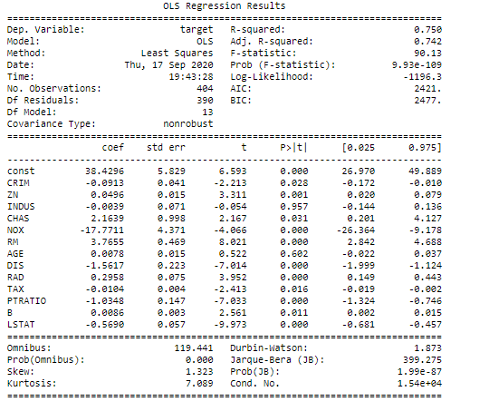
Results

Slide 27
In Class Example

